Slide 1
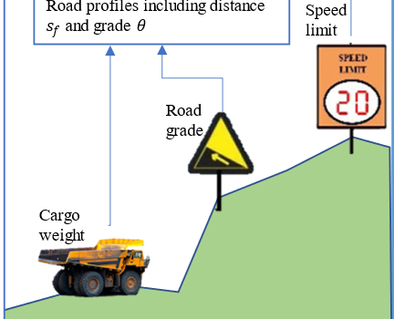
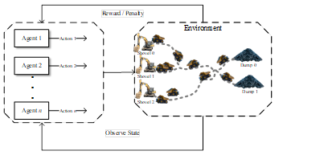
Introduction of Research Experience
Applicant: Shuwei Pei
University of Science and Technology Beijing
peishuwei9@live.com
Please feel free call me Travid
Project 1: Velocity Optimization For Autonomous Vehicles
Project 2: Learning-based Fleet Dispatching System
Notes:
Good morning, professors.
I am Shuwei Pei from university of science and technology Beijing, please feel free call me Travid
Today, I am going to make an introduction regarding academic and research background. Hope we can have a further discussion.

Slide 2
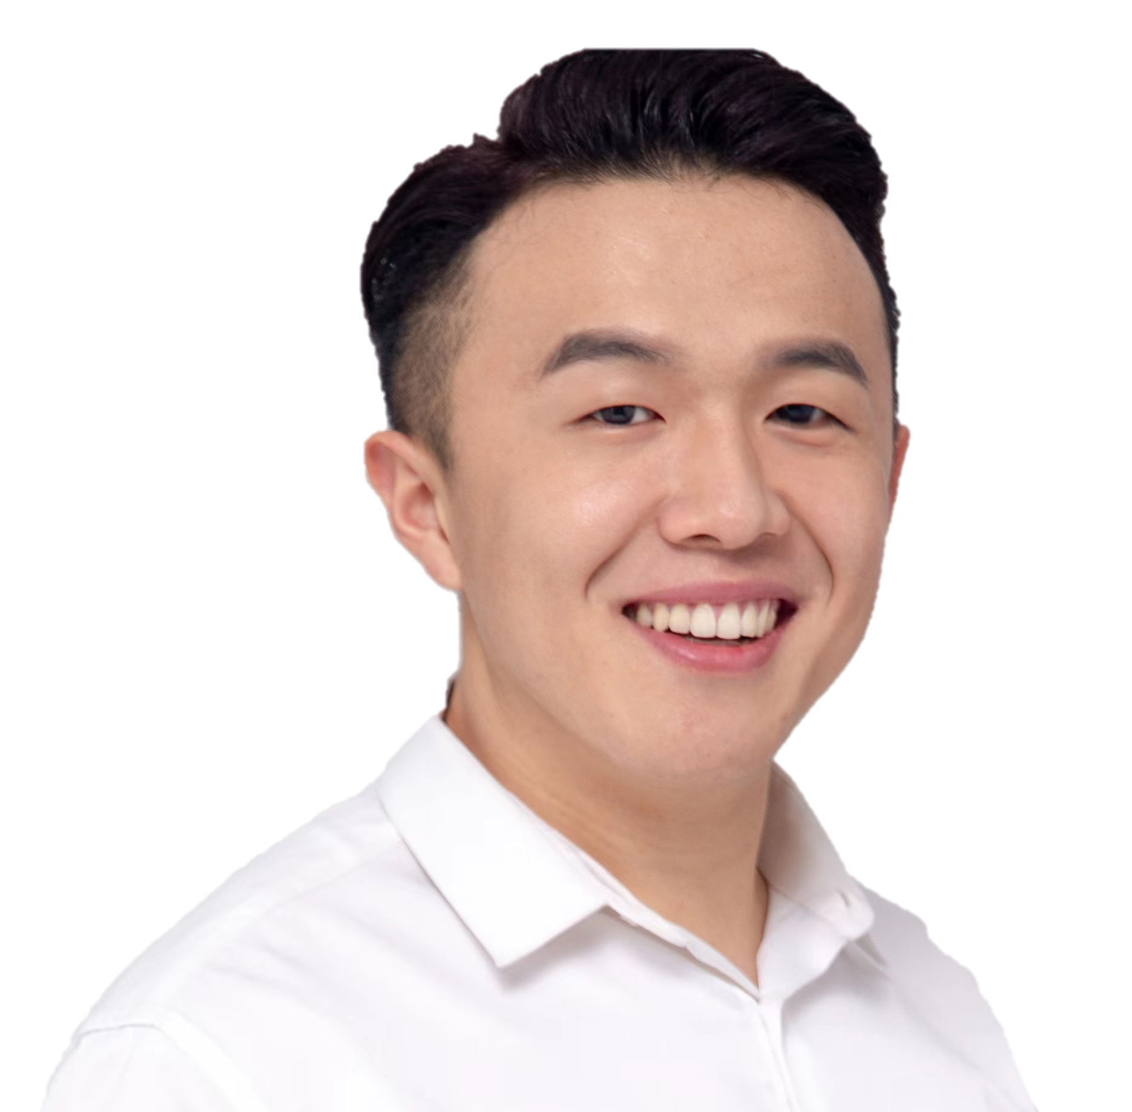
Personal Background
1. Education
University of Science and Technology Beijing | GPA: 3.62/4.0—Beijing, CHN
M.E. in Mechanical Engineering | September 2021 - June 2024 (expected)
University of Science and Technology Beijing | GPA: 3.68/4.0—Beijing, CHN
B.E. in Vehicle Engineering | September 2017 - June 2021
National Taipei University of Technology | GPA: 3.82/4.0—Taipei, CHN
Exchange Student in Vehicle Engineering | September 2019 - January 2020
2. Awards
The Second Price Scholarship, University of Science and Technology Beijing, 2023&2022
The Second Price Scholarship, Roberto Rocca Scholarship, 2023 National Second Prize, China Industrial Internet Contest, 2021 Outstanding Graduates, University of Science and Technology Beijing, 2021
Merit Student, University of Science and Technology Beijing, 2018
Shuwei Pei / Travid
Looking for a PhD position for fall 2024.
3. Skills
Programming: MATLAB, LaTeX, Python, Pytorch, C/C++, Simpy
Software: SolidWorks, CAD, Carsim, Simulink
Languages: IELTS 7.5
Research Interest
Reinforcement Learning
Automated Driving
Intelligent Transportation
Control and Plan
Notes:
I received the B.S. degree in 2021 from the School of Mechanical Engineering, University of Science and Technology Beijing, Beijing, China, where I am currently working toward the M.S. degree with the School of Mechanical Engineering. I had a chance to be selected as an exchange student to Taipei Taiwan, where I have learnt some language skills.
Currently, I am Looking for a PhD position for fall 2024.

Slide 3
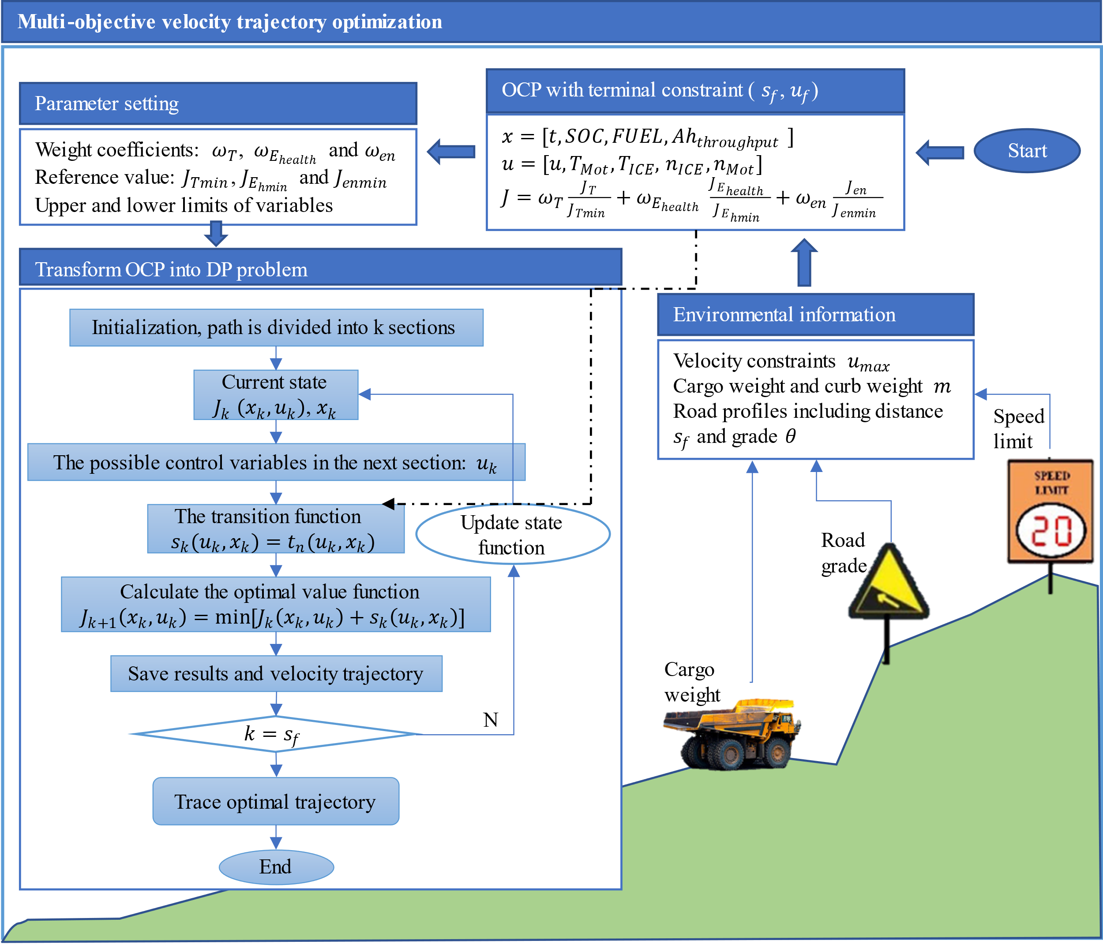

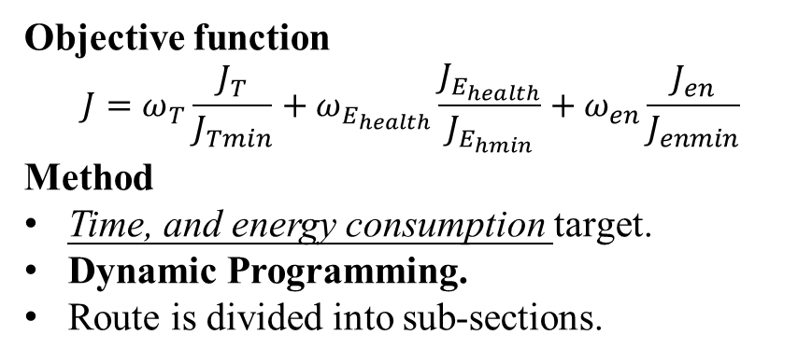
Research Experience
Publications
Shuwei. Pei and Jue. Yang, "Multi-objective Velocity Trajectory Optimization Method for Autonomous Mining Vehicles," Int J Automot Technol, vol. 24, no. 6, pp. 1627-1641, 12 2023, doi: 10.1007/s12239-023-0131-5.
The costs for the transportation?
Energy consumption
Contribution
Less time and runs more smoothly with fewer velocity fluctuations.
Reduce the battery capacity loss.
It is more suitable mining transportation.
Objective function
$$J=ω_{T}\frac{J_{T}}{J_{Tmin}}+ω_{E_{health}}\frac{J_{E_{health}}}{J_{E_{hmin}}}+ω_{en}\frac{J_{en}}{J_{enmin}}$$
Method
Time, and energy consumption target.
Dynamic Programming.
Route is divided into sub-sections.
Notes:
I have written 2 essays and participated 2 projects
Tittle: we proposed a multi-objective optimization method for autonomous vehicles. In conventional mining transportation, the overall transport cost is mainly related to the energy consumption, including the fuel and electricity.
Outcome
Compared with the single energy objective optimization. It can use the fewer time and run faster, with less velocity fluctuations.
If it was the electrical car, the battery will be protected properly. The capacity loss will be reduced.
All in all, this method will be more suitable for the mining transportation. And it can give some guidance and reference for the mining company.
Method,
A multi objective target equation was constructed in this study. The parameter can be adapted according to the environments.
It include energy, travel efficiency, and battery health (EV). The battery is specialized for the electric car.
Dynamic Programming algorithm is used to search the best velocity. The goal is to minimize the cost equation.
Firstly, The geography information was obtained including the grade and distance.
Secondly, we try to model the vehicle according to the powertrain configuration, which would be the foundation for us to get the real Time and Energy consumption.
After that, the Route will be divided into sub-sections in terms of the fixed distance. During each small segment. We will search for best velocity and calculate all the possible velocity’s consumption and costs. They will find the best velocity which can minimize the objective function. The process will be calculated step by step, until get the end of the route. The best velocity can be got in this way.
The best trajectory is extracted.

Slide 4
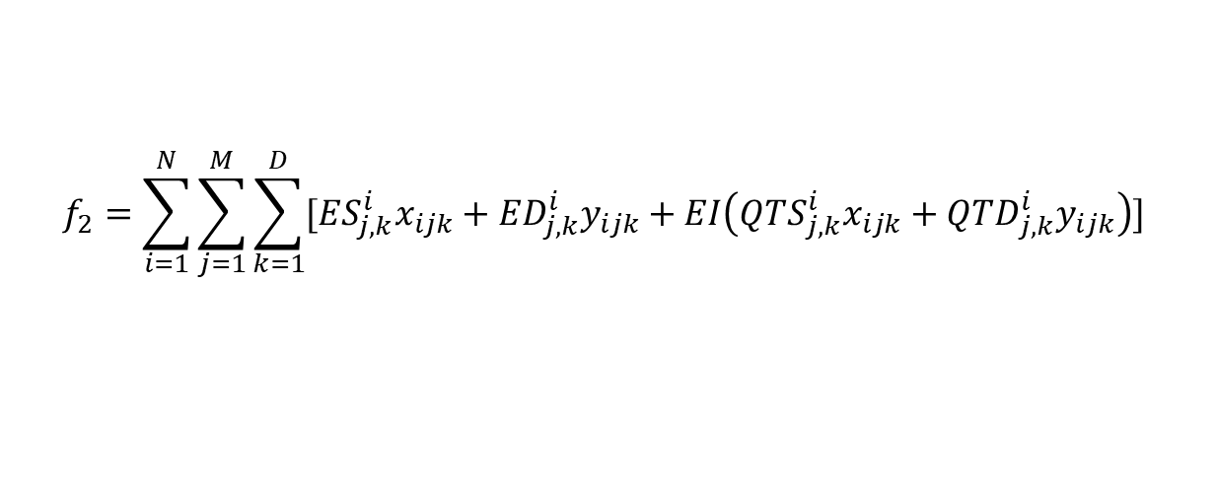
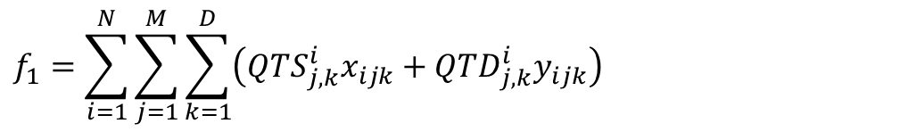
Research Experience
Publications
Shuwei. Pei and Jue. Yang, "An Integrated Dispatching Framework with Trajectory Optimization for Improving Autonomous Mining Transportation," IEEE Transactions on Intelligent Vehicles,2023 Submitted.
Minimize Queue Time:
Minimize Transportation Time:
$$f_{1}=\sum_{i=1}^{N}{\sum_{j=1}^{M}{\sum_{k=1}^{D}{\left({QTS}_{j,k}^{i}x_{ijk}+{QTD}_{j,k}^{i}y_{ijk}\right)}}}$$
$$f_{2}=\sum_{i=1}^{N}{\sum_{j=1}^{M}{\sum_{k=1}^{D}{[{ES}_{j,k}^{i}x_{ijk}+{ED}_{j,k}^{i}y_{ijk}}}}+EI\left({QTS}_{j,k}^{i}x_{ijk}+{QTD}_{j,k}^{i}y_{ijk}\right)]$$
Queueing time?
Deep Q–Network is used to train this system：
10% reduction in energy consumption.
3k ton increase in production.
More balanced tasks compared with fixed schedule.
Robustness.
Notes:
In mining operations, queuing for loading accounts for the most time for trucks, resulting in the inefficiency of the dispatching system.
we try to design a dispatching system to alleviate the queuing situation.
Method:
The mathematical modelled is set up according to the physical constraints. There are basically two aims that need to be optimized.
The first is set for the Queueing time for the dump and loading position. The second is established for minimizing the transporting time.
I used the python and Pytorch to program the learning lased simulation system
Outcome
Compared the fixed conventional dispatching system
10% reduction in energy consumption because of the velocity optimization.
The queue time in the dump and shovel site decreased significantly, resulting in 3k ton increase in production
It generate more balanced tasks compared with Fixed Schedule. It will improve the usage for the road.
Additionally, it can show some robustness in handling some truck failure.

Slide 5
Research Experience
Publications
Shuwei. Pei and Jue. Yang, "An Integrated Dispatching Framework with Trajectory Optimization for Improving Autonomous Mining Transportation," IEEE Transactions on Intelligent Vehicles,2023 Submitted.
Multi-agent reinforcement learning.
Each truck --- individual agent.
Deep Q learning network.
Observation state-action-reward.
Self update actions and rewards.
Notes:
Firstly, Multi-agent reinforcement learning method was involved in this study. Each truck was seen as an individual agent. And the action is the next dump site or loading position. We need capture the truck queue numbers and queueing conditions at each dump site and load site as observation state.
The reinforcement learning system adopted the Deep Q learning network.
It will give the best action to each truck when they finished their task according to the observation.
When the truck gets the action, they will go the assigned destination. During the travel, the truck will run will the best velocity which is also the velocity optimization method in my first paper.
When the truck finished the task, the system will calculate the reward for this action to check if it was good enough. The DQN system will self update through the quantities of experiments actions and rewards. Then it will take the right action gradually and gradually.

Slide 6
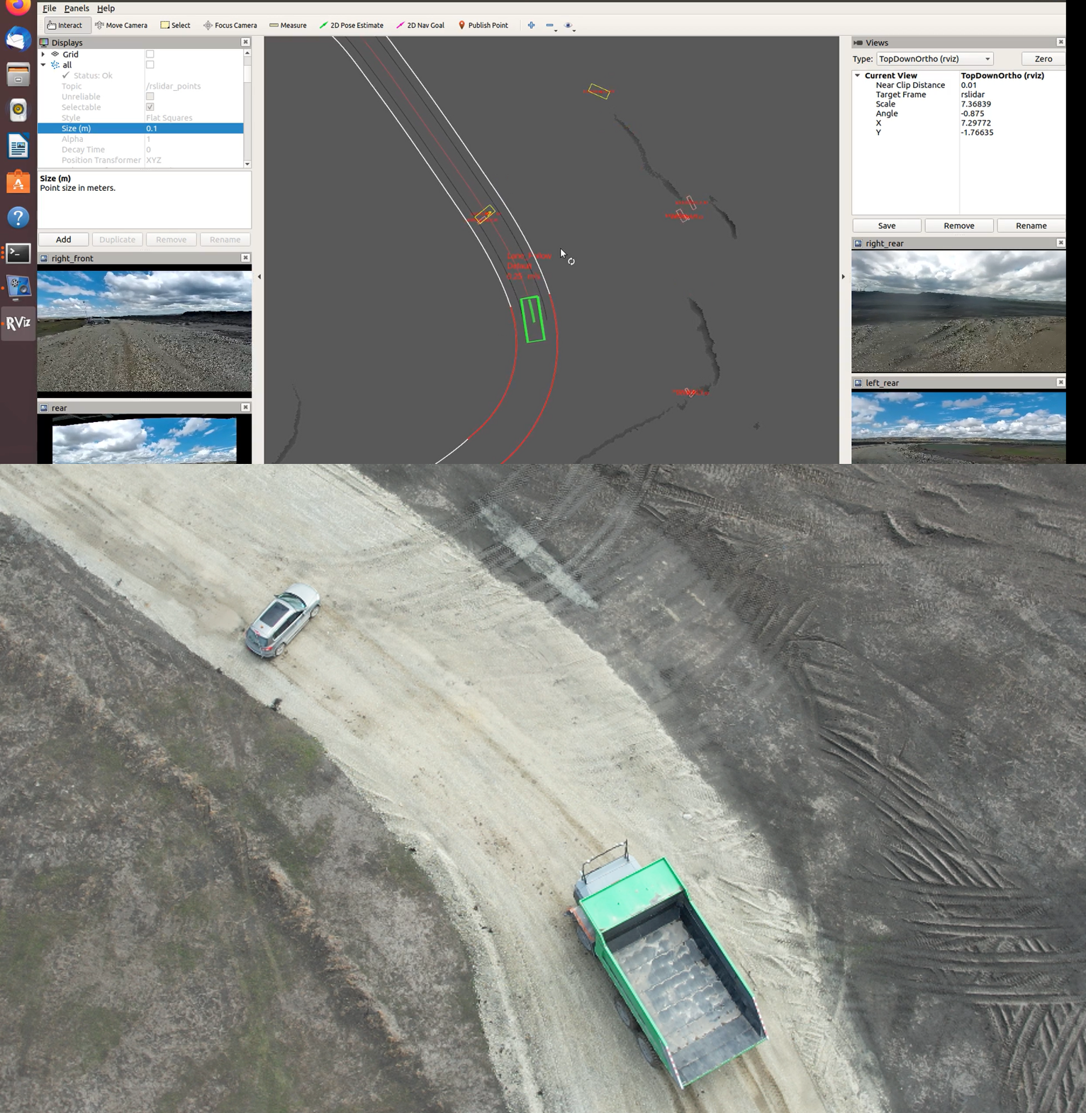
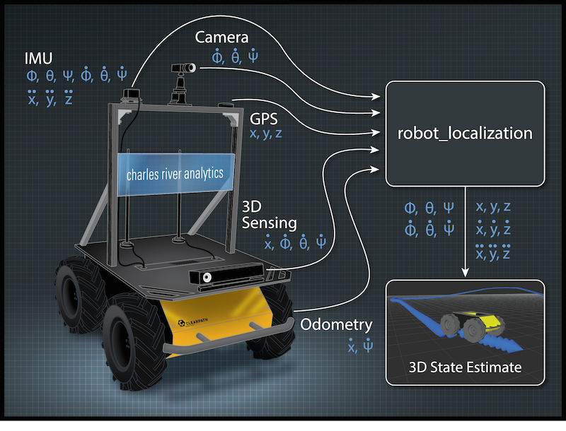
Research Experience
3. Cooperation Project
The Electric Autonomous Mining Truck Without Cabin
Battery exchange transfer system, autonomous driving.
Analyzed and diagnosed the breakdown.
Dispatched vehicles in a closed area using intelligent system
4. Student Research Project
Theoretical Research on Autonomous Vehicles Based on ROS2
Designed autonomous driving system for location, perception and planning.
RRT search algorithm and MPC were used.
Tested vehicles in the gazebo simulation environment.
Notes:
Apart from the above 2 papers. I also was involved some cooperation project with my supervisor. this is cooperated with companies to solve the mining transportation problems
1. Designed a solution for battery exchange transfer system, remote control, and installed the various sensors.
2. Analyzed and diagnosed the breakdown of autonomous vehicle, including TCS track , EBS braking and Hydraulic steering system.
3. Dispatched 10 vehicles in a closed mining area by using the intelligent system in real-time. Enhanced the full-time autonomous operation capability to reach more than 120% of the manual by EV trucks
It improved the existing transportation and production and safety, efficiency.
energy, efficiency, and battery health (EV).
Another is a student research program.
Based on ROS2 in the Ubuntu22.04 system, we have done some Theoretical Research on Autonomous Vehicles.
We have built some nodes for perception, location, path planning,
RRT search algorithm was used to find the feasible path, and MPC was used to track and control.
Tested vehicles in the gazebo simulation environment.

Slide 7



Working Experience
Internship
China National Heavy Duty Truck Group Co., Ltd. | Jinan, CHN
Intern in Light Truck | July 2022-September 2022
Modified the truck chassis for achieving refrigerator car standards and functions.
German Association of the Automotive Industry | Beijing, CHN
Intern in China Office | September 2020 - December 2020
Office administrative work and translation about the automotive industry.
Midea Group Co., Ltd. | Foshan, CHN
Intern in Lean Management | June 2020 - August 2020
Improved logistics and transport efficiency for manufacturing in plants.
Notes:
this is cooperated with 3 companies to coolaborate
During some vocation, I have done some part time job in three companies, including the car design and modification, office work and manufacturing. Although it is not very important, it improved my interpersonal skills and more professional guidance.

Slide 8
PhD Research Interest
Research Interest
Be open to the related area
Deep Reinforcement Learning, Intelligent Transportation System,
Automated Driving, Control and Optimization
Self Statement
Highly motivated and self-directed individual.
Strong sense of responsibility and cooperation.
Innovative and active.
Proficiency in English.
CSC scholarship is applicable.
Detailed information on my personal website. Personal information | Shuwei Pei / Travid (travidp.github.io)
Notes:
At last, my research interest mainly focus on the following aspects.
But I will Be open to the related area
I think I am a highly motivated and responsibility,
Handle the complex problem

Slide 9
Thanks for your attention!
Applicant: Shuwei Pei
University of Science and Technology Beijing
peishuwei9@live.com
Please feel free to reach out any questions
Notes:
My presentation comes to an end.

